Slide 1

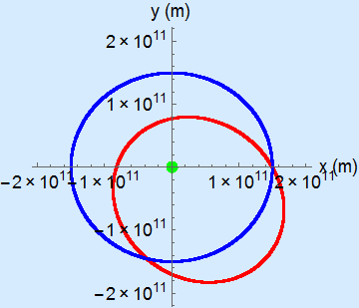
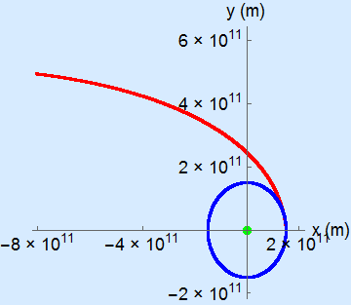
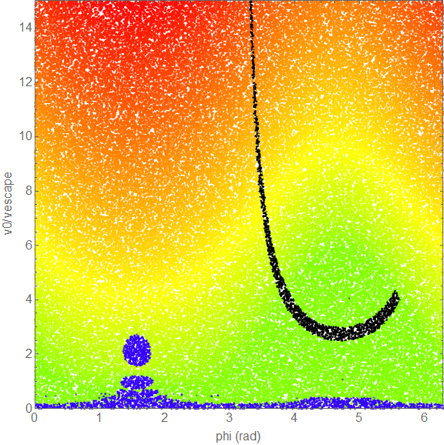
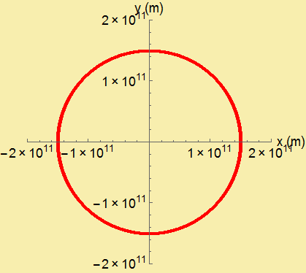
Shooting Nuclear Waste at the Sun
a viable option?
Christine Helms, Computational Methods in Physics, Spring 2015
Introduction:
With x-many nuclear power plants in the world producing x-much waste a year, storage of nuclear waste has become an important topic [1]. One suggestion is to launch nuclear waste at the sun. This options requires launch technologies that are capable to speeds exceeding the escape velocity of the Earth. These velocities are a limitation but may be surpassed as technology develops therefor we consider the feasibility of launching nuclear waste at the sun.
Physics and Methods:
We minimized our system to contain only the Earth, Sun and a projectile. We then modeled the trajectory of the projectile, Earth and sun as time evolved. We tested different launch angles and velocities to determine which effectively hit the sun with in 3 years of launch.
The motion of the system and the projectile was described by the force of gravity. Where the force on the projectile is given below.
Setting our origin at the center of mass we could define our system and track the projectile (see figure 1). Using the three point centered algorithm to solve differential equation given by the forces equation we were able to track the projectile.
Figure 2. The path taken by the projectile after launch with difference launch angles (phi) and velocities as a multiple of the escape velocity of Earth (v_{esc} = 1.1 x 10⁴); A: phi -3.5 rad, velocity - 1.3 v_{esc}, B: phi - 2 rad, velocity - 1 v_{esc}. The path of the Sun is shown in green, the Earth in blue and the projectile in red.
Figure 3. Two body system of the Sun and the projectile. When the projectile is launch with the correct orbital velocity it does indeed orbit the sun.
Figure 5. Heat map of the final position of the projectile. Black indicates the projectile hit the Sun, Blue the projectile hit the earth, the shading from green to red indicates the final distance from the center of mass with the most distant outcomes in red.
Conclusions:
The number of launch conditions that hit the sun and minimal compared to the total number available. In addition launch velocities at a minimum of three times the escape velocity of earth are required. For both of these reason, we do not consider launching nuclear waste at the sun a viable option for nuclear waste disposal.
projectile
Results:
We were able to track the full trajectory of the projectile as shown in figures 2 and 3. We could verify our code was working correctly by eliminating the earth and setting the projectile into orbit around the sun by giving it the correct velocity for the given radius of orbit (figure 3). Seeing we only care about the final position of the projectile we collected data on its location after 3 years for various initial conditions (Figure 4)
d_{S}
d_{E}
v₀
φ
L _{S}
L _{E}
M_{E}
References:
Text 1 that was used in Introduction and background
Article 2 that was used
Reference 3 that was use
M_{S}
center of mass
Figure 1. Schematic of the set up for the problem. The Earth and sun orbit their center of mass, technically located inside the sun but shown outside for visualization. A projectile is launch from the earth at a given angle and velocity.

